Slide 1
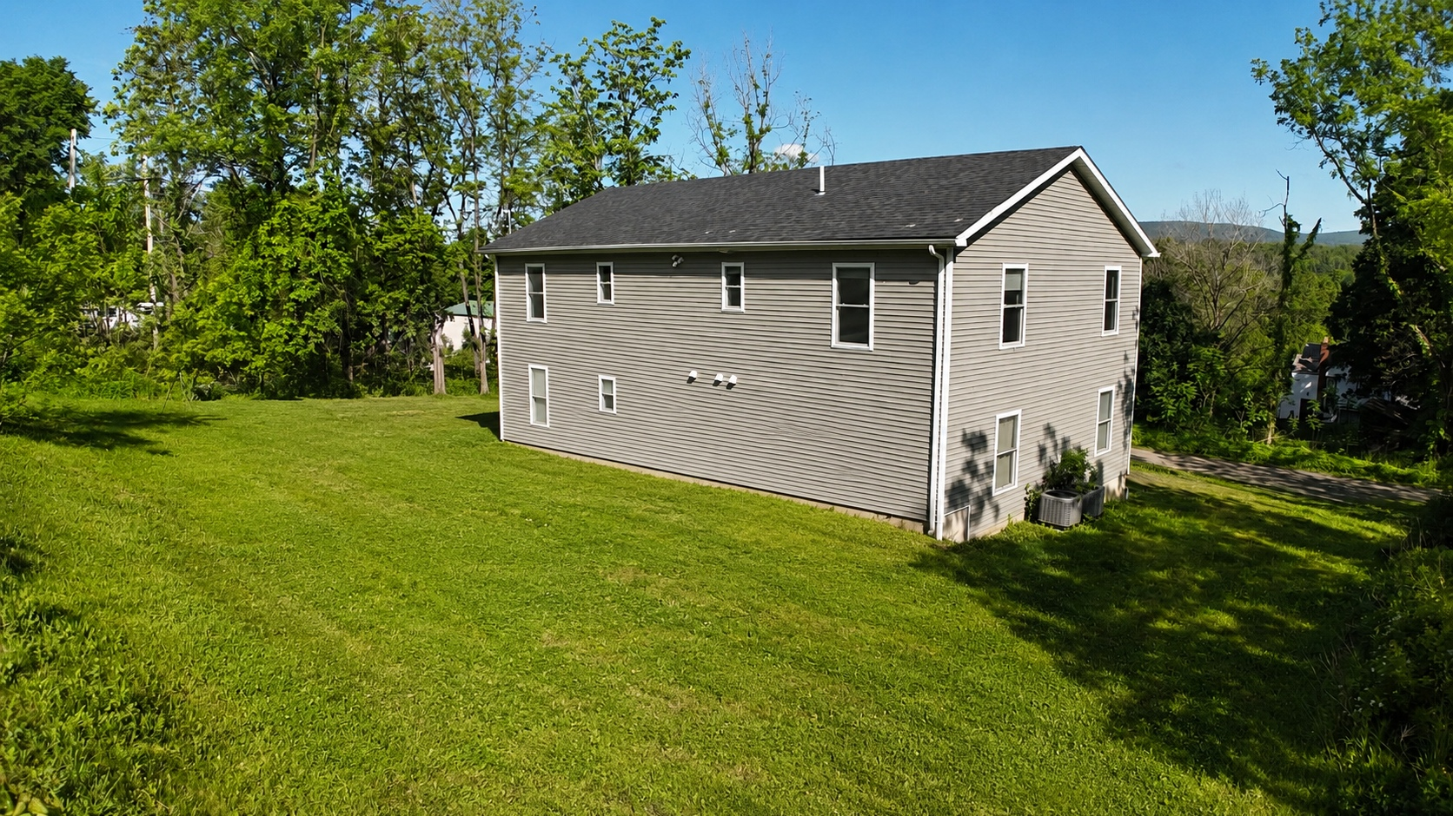
23 Highland Avenue
Kerhonkson, NY 12446
Preliminary Multifamily
Valuation
Prepared for client discussion by 360 Property Group
4 units • 12 beds • 8 baths
Subject configuration stated
$1.05M–$1.30M
$1.15M–$1.25M
Preliminary range
Target band
Ryan Sylvestri, Associate Real Estate Broker
Preliminary broker value opinion. Not an appraisal.

Slide 2
Executive Positioning
Use a blended sales-comparison and income approach; do not anchor to the historic sale alone.
$1.05M–$1.30M
$1.15M–$1.25M
$1.295M+
Preliminary support range
Fair market target band
Aggressive ask threshold
Why this framing works
Client-facing conclusion
• Public sale data appears incomplete for the current asset.
• Current information supports four 3-bed / 2-bath apartments.
• The property is 75% occupied: three occupied units, one vacancy.
• Projected market rent is modeled at $2,650/month per unit.
Assuming the four-unit configuration is legal, complete, rentable, and separately marketable:
Present the property as a stabilized small multifamily asset with support in the low-to-mid $1M range.
Preliminary broker value opinion — not an appraisal. Verify municipal records, legal units, leases, rent roll, taxes, utilities, insurance, and expenses before reliance.
2

Slide 3
Subject Evidence & Diligence
Separate the pricing story from the items that still need record verification.
Configuration premise
Occupancy premise
4 units • 12 bedrooms • 8 full baths. Modeled as four
3-bed / 2-bath apartments.
75% occupied: three occupied units and one vacant unit.
Rent premise
Record mismatch
Projected market rent of $2,650/month per unit; gross
scheduled rent of $127,200/year.
The 2022 $450,000 public sale should not be used as the
primary pricing anchor.
Verify before final pricing
• Legal unit count and certificate of occupancy status.
• Whether 23 and 25 Highland are one economic asset or separate parcels.
• Rent roll, leases, deposits, taxes, utilities, insurance, and annual expenses.
Preliminary broker value opinion — not an appraisal. Verify municipal records, legal units, leases, rent roll, taxes, utilities, insurance, and expenses before reliance.
3

Slide 4
Comparable Benchmarks: Primary Support
Each comp is shown as a card to avoid dense tables and small fonts.
1
57 Samsonville Rd, Kerhonkson
2
181 Glenerie Blvd, Lake Katrine
Active • $1,199,000
Active • $895,000
10 bed / 12 bath • 4,448 SF • $270/SF
12 bed / 7 bath • 4,544 SF • $197/SF
Closest local multifamily benchmark. Extended market exposure
tempers direct pricing weight.
Similar bedroom count and useful broader Ulster County income-
property support.
3
585 Popletown Rd, Ulster Park
Primary read
Closed • $550,000
7 bed / 3 bath • 2,575 SF • $214/SF
The best support clusters around roughly
$195–$240/SF before adjusting for location, unit
legality, condition, and current income strength.
Smaller sold benchmark. Useful for $/SF support, but inferior
scale and bath count.
Preliminary broker value opinion — not an appraisal. Verify municipal records, legal units, leases, rent roll, taxes, utilities, insurance, and expenses before reliance.
4

Slide 5
Comparable Benchmarks: Broader Context
These comps bracket the range but should carry less weight than closer and more similar assets.
4
95 Green St, Kingston
5
25 Adams St, Kingston
Closed / public record • $1.25M–$1.44M shown
Active • $475,000
14 units / 15 beds • 6,688 SF • $187–$215/SF
Quadruplex • 4,487 SF • $106/SF
Larger Kingston benchmark. Useful for $/SF context; unit mix and
location differ.
Low-end/condition floor. It is not a direct pricing target for
the subject.
6
103 Carney Rd, Ulster Park
Weighting note
Closed • $2,275,000
3 residences • 7 beds • 5,177 SF • $439/SF
Use Kingston and Ulster Park examples as bracket
support. The stronger client argument is income
strength plus the closest Kerhonkson benchmark.
High-side outlier. Shows rural income-property upside but should
not anchor value.
Preliminary broker value opinion — not an appraisal. Verify municipal records, legal units, leases, rent roll, taxes, utilities, insurance, and expenses before reliance.
5

Slide 6
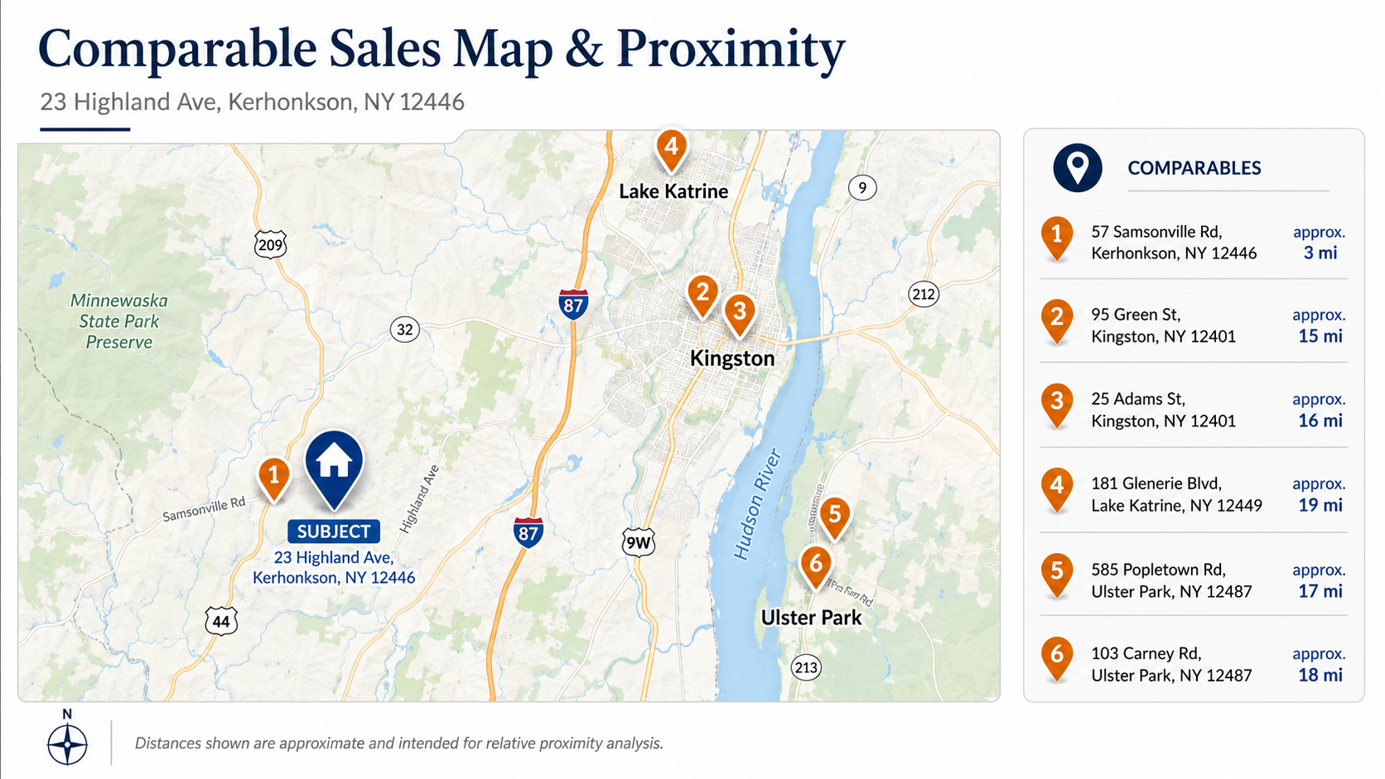

Slide 7
Income Analysis
The income-supported range is consistent with the comparable-sales indication.
$2,650
$127,200/yr
Income read
Monthly rent per unit
Gross scheduled rent
At the current rent indications, the property clears
the $1M threshold quickly if the operating expense
profile is normal for a small multifamily asset.
35%–40%
$76K–$83K
Modeled expense load
Estimated NOI
Most defensible listing band
$1.15M–$1.25M
Cap-rate indications
7.50% cap: $1.01M–$1.11M
7.00% cap: $1.09M–$1.19M
6.50% cap: $1.17M–$1.28M
6.25% cap: $1.22M–$1.33M
Push above this only if legal status, rent roll,
condition, taxes, insurance, utilities, and operating
expenses verify cleanly.
Preliminary broker value opinion — not an appraisal. Verify municipal records, legal units, leases, rent roll, taxes, utilities, insurance, and expenses before reliance.
7

Slide 8
Recommended Positioning
Lead with a disciplined range and condition the top end on clean documentation.
Conservative value
Fair market target
Aggressive ask
$1.05M–$1.15M
$1.15M–$1.25M
$1.295M+
Use if documentation is incomplete or
operating expenses are uncertain.
Best current presentation band based on
income and multifamily benchmarks.
Only supportable if legal status, rent
roll, condition, and expenses verify
cleanly.
Positioning language
Based on the closest available multifamily benchmarks and current rent evidence, I would present the property in the
$1.15M to $1.25M range, with broader preliminary support from $1.05M to $1.30M. Before relying on the top end, I would
verify legal unit count, CO status, parcels, taxes, utilities, leases, and operating expenses.
Next step:
Confirm municipal records and parcel structure for 23/25 Highland before final pricing or listing recommendation.
Preliminary broker value opinion — not an appraisal. Verify municipal records, legal units, leases, rent roll, taxes, utilities, insurance, and expenses before reliance.
8

