Slide 1
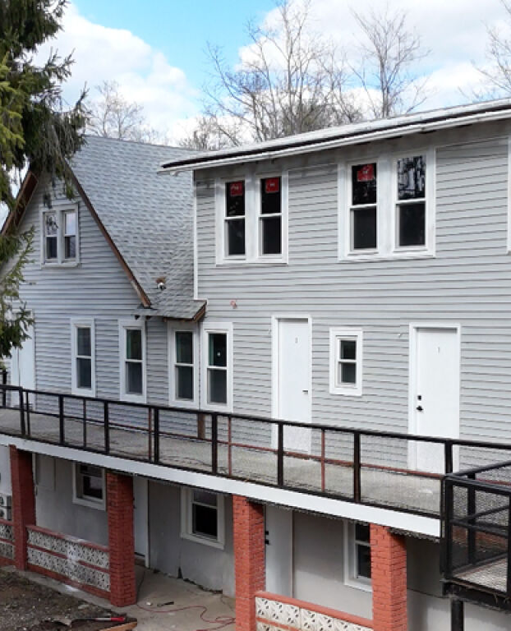
23 Highland Avenue
Kerhonkson, NY 12446
Preliminary multifamily value analysis prepared for client discussion
4 units • 12 beds • 8 baths
Subject configuration stated
$1.05M–$1.30M
Preliminary value range
$1.15M–$1.25M
Fair market target band
Prepared by Ryan Sylvestri
Image/source reference: Shawangunk Journal housing article image for local multi-unit context; not represented as subject property.

Slide 2
Executive Positioning
The best current support is a blended sales-comparison and income approach, not the 2022 public sale alone.
$1.05M–$1.30M
$1.15M–$1.25M
$1.295M+
Preliminary range
Target discussion band
Aggressive ask threshold
Why this is the correct framing
Client-facing conclusion
• Public-sale data for 23 Highland shows a 2022 sale at $450,000, but the current rental/listing data indicates a materially different income asset.
• The current unit-level evidence supports four rentable 3-bedroom apartments with strong rent indications.
• The cleanest valuation story is: legal/unit verification first, then price against nearby multifamily and gross-rent support.
Assuming the four-unit configuration is legal and all units are complete, rentable, and separately marketable, the property should be presented as a stabilized small multifamily asset with pricing support in the low-to-mid $1M range.
Sources: Zillow, Apartments.com, Coldwell Banker Prime rental listing pages; Realtor.com and brokerage listing pages for comparable multifamily assets.
Preliminary broker opinion • Verify legal units, COs, taxes, rent roll, utilities, and parcel mapping before client reliance
2

Slide 3
Subject Evidence: Verify the Asset Before Anchoring Price
The public-record and active rental descriptions do not appear to describe the same asset with the same level of completeness.
Data Point | What It Shows | Presentation Treatment
Public sale / property data | $450,000 sale on Jan. 24, 2022; public record size/bath data appears smaller than full 4-unit description. | Do not use as the primary valuation anchor without deed/parcel review.
Current Unit A rental evidence | Unit A marketed around $2,650–$2,750/mo; 3 beds / 2 baths; approx. 1,344 sq. ft. in one source. | Supports new-construction apartment-level rent assumptions.
Current Unit B / 25 Highland evidence | Separate unit pages show additional 3-bedroom rental/apartment data. | Supports the premise that the income asset may include 23 and 25 Highland.
Broker diligence requirement | Confirm legal units, COs, tax parcels, rent roll, lease terms, utilities, and actual GLA. | Required before final BPO or pricing recommendation.
Key Risk
If the property is legally only a duplex or if 23 and 25 Highland are separate parcels with different ownership, the valuation logic changes materially.
Sources: Zillow rental page for 23 Highland Ave #B; Apartments.com and Homes.com/Coldwell Banker rental listing pages for Unit A; public listing pages referenced in research.
Preliminary broker opinion • Verify legal units, COs, taxes, rent roll, utilities, and parcel mapping before client reliance
3

Slide 4
Comparable Sales / Market Benchmarks
True 4-unit, 12-bedroom Kerhonkson sold comps are scarce, so the analysis widens to nearby Ulster County multifamily benchmarks.
Comparable | Status | Price | Units / Bed-Bath | SF | $/SF | Use in Analysis
57 Samsonville Rd, Kerhonkson | Active | $1,199,000 | 10 bed / 12 bath | 4,448 | $270 | Closest local multifamily benchmark; long DOM tempers weight.
181 Glenerie Blvd, Lake Katrine | Active | $895,000 | 12 bed / 7 bath | 4,544 | $197 | Similar bed count; broader Ulster County income comp.
585 Popletown Rd, Ulster Park | Closed | $550,000 | 7 bed / 3 bath | 2,575 | $214 | Smaller sold comp; useful $/SF support.
95 Green St, Kingston | Closed / public record | $1.25M–$1.44M shown | 14 units / 15 beds | 6,688 | $187–$215 | Larger Kingston benchmark; location/unit mix differs.
25 Adams St, Kingston | Active | $475,000 | Quadruplex | 4,487 | $106 | Low-end/condition floor, not direct pricing target.
Comparable Interpretation
Relevant small-multifamily support clusters around roughly $195–$240/SF, with the closest active Kerhonkson benchmark asking near $270/SF but carrying extended market exposure.
Sources: Realtor.com/Zillow for 57 Samsonville; Realtor.com/Zillow/Berardi/Coldwell Banker for 181 Glenerie; Compass for referenced closed benchmarks; Signature Premier for 25 Adams.
Preliminary broker opinion • Verify legal units, COs, taxes, rent roll, utilities, and parcel mapping before client reliance
4

Slide 5
Income Sanity Check
The rent-supported value range is broadly consistent with the sales-comparison indication.
Assumption | Calculation | Result
Monthly rent per unit | $2,650 × 4 units | $10,600/mo
Gross scheduled rent | $10,600 × 12 | $127,200/year
Estimated expense / vacancy load | 35%–40% | NOI approx. $76K–$83K
Value @ 7.50% cap | $76K–$83K ÷ 0.075 | $1.01M–$1.11M
Value @ 7.00% cap | $76K–$83K ÷ 0.070 | $1.09M–$1.19M
Value @ 6.50% cap | $76K–$83K ÷ 0.065 | $1.17M–$1.28M
Value @ 6.25% cap | $76K–$83K ÷ 0.0625 | $1.22M–$1.33M
Income Read
At the current rent indications, the property clears the $1M threshold quickly if the units are legal and the operating expense profile is normal for a small multifamily asset.
Most defensible band
$1.15M–$1.25M
Push above this only with clean legal status, strong leases, low owner-paid utility exposure, and verifiable taxes/insurance.
Sources: Current rental listing evidence at approximately $2,650–$2,750/month per unit; cap-rate math is preliminary and should be replaced by actual operating statements.
Preliminary broker opinion • Verify legal units, COs, taxes, rent roll, utilities, and parcel mapping before client reliance
5

Slide 6
Recommended Client Position
Lead with a disciplined range, then condition the final number on diligence that confirms the asset actually supports four stabilized apartments.
Position | Recommended Use | Client Message
Conservative value | $1.05M–$1.15M | Appropriate if documentation is incomplete or operating expenses are uncertain.
Fair market target | $1.15M–$1.25M | Best current presentation band based on income and multifamily benchmarks.
Aggressive ask | $1.295M+ | Only supportable if rent roll, unit legality, condition, taxes, insurance, and utilities are all clean.
Final Client Script
“Based on the closest available multifamily benchmarks and the current rent evidence, I would present the property in the $1.15M to $1.25M range, with a broader preliminary support range of $1.05M to $1.30M. Before we rely on the top end, I would want to verify the legal unit count, certificate of occupancy status, parcels, taxes, utilities, leases, and operating expenses.”
Immediate next step: pull municipal/tax records and confirm whether 23 and 25 Highland are one economic asset or separate parcels/records.
Prepared as a preliminary presentation, not an appraisal. Final opinion requires verified records and MLS/tax-source confirmation.
Preliminary broker opinion • Verify legal units, COs, taxes, rent roll, utilities, and parcel mapping before client reliance
6

